Slide 1

Distant supervision for relation extraction without labeled data (2009)
Mike Mintz, Steven Bills, Rion Snow, Dan Jurafsky
Roderick Perez, ph.d
April, 22th, 2021

Slide 2
OUTLINE
Summary
Introduction
Entities, relations and events
Motivation
Relation Extraction
FreeBase
Approaches
Training and Testing
Results
Conclusions
Discussion

Slide 3

DISTANT SUPERVISION sUMMARY
train
relations database
annotate
train
unannotated data
Notes:
MOTIVATION: Produce a technique that does not depend on labeled corpora – thus avoiding the domain dependence of ACE style algorithms which also supports the use of large size corpora.
Use existing database and unannotated data to train classifier, then annotate the new data.
What we want to do? Extract the relation between entities from sentences…

Slide 4
DISTANT SUPERVISION sUMMARY
train
relations database
annotate
train
Schönbrunn, is a famous place in Vienna.
unannotated data
Notes:
MOTIVATION: Produce a technique that does not depend on labeled corpora – thus avoiding the domain dependence of ACE style algorithms which also supports the use of large size corpora.
Use existing database and unanntated data to train classifier, then annotate the new data.
What we want to do? Extract the relation between entities from sentences…

Slide 5
DISTANT SUPERVISION sUMMARY
train
relations database
annotate
train
Schönbrunn, is a famous place in Vienna.
location - contains
unannotated data
<Schönbrunn, Vienna>
Notes:
MOTIVATION: Produce a technique that does not depend on labeled corpora – thus avoiding the domain dependence of ACE style algorithms which also supports the use of large size corpora.
Use existing database and unanntated data to train classifier, then annotate the new data.
What we want to do? Extract the relation between entities from sentences…

Slide 6
Entities, Relations and Events
Entities: persons, organizations, locations, facilities, weapons, vehicles, and geo-political entities.
38 years old Roderick Perez study a Master in Data Science at the University of Vienna is the father of Lea and Amy…

Slide 7
Entities, Relations and Events
Entities: persons, organizations, locations, facilities, weapons, vehicles, and geo-political entities.
Relations (between entities): an ordered, binary relation between entities. For example: role, part, located, near, and social.
38 years old Roderick Perez study a Master in Data Science at the University of Vienna is the father of Lea and Amy…
X is the father of Y and Z

Slide 8
Entities, Relations and Events
Entities: persons, organizations, locations, facilities, weapons, vehicles, and geo-political entities.
Relations (between entities): an ordered, binary relation between entities. For example: role, part, located, near, and social.
Events: interaction, movement, transfer, creation and destruction.
38 years old Roderick Perez study a Master in Data Science at the University of Vienna is the father of Lea and Amy…
X study at Y

Slide 9
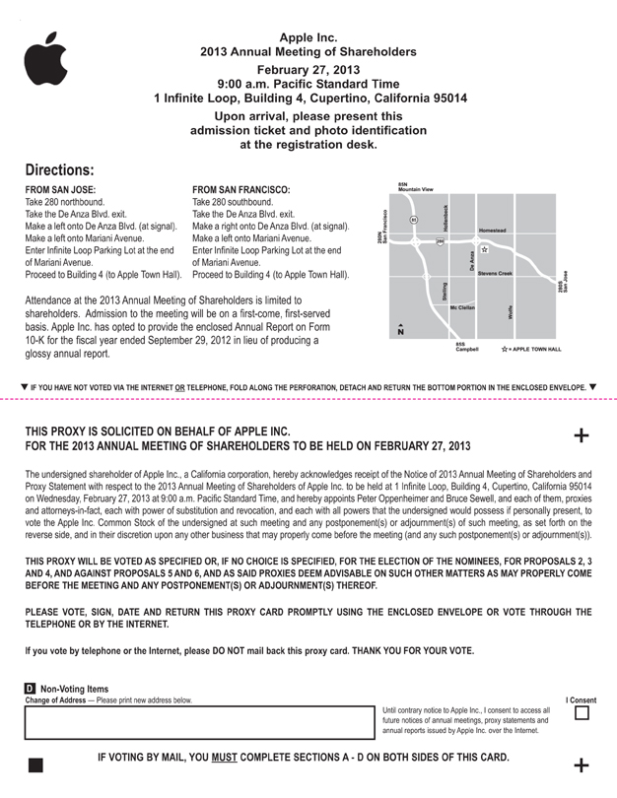
Motivation What is relation extraction?
Company Report Meeting [2013]
“The undersigned shareholder of Apple Inc., a California corporation, hereby acknowledges receipt of the Notice 2013 Annual Meeting of Shareholders and Proxy Statement with respect to 2013 Annual Meeting Shareholders of Apple Inc. to be held at Infinite Loop, Building 4, Cupertino, California 95014 on Wednesday, February 27, 2013 at 9:00a.m. Pacific Standard Time…”
Extracted Complex Relation:
Relation triples:
Company – Meeting Invitation
Company: Apple Inc.
Location: Infinite Loop, …, California 95014
Date: February 27, 2013
Time: 9:00a.m. Pacific Standard Time
meeting – location (Apple, California)
meeting – year (Apple, 2013)
meeting – time (Apple, 9:00a.m.)
Source: SEC.gov
Notes:
Why?
Create structured knowledge bases, useful for further applications in NLP
Augment current knowledge bases (Adding words to WordNet thesaurus, facts to FreeBase or DBPedia)

Slide 10
abstract
Alternative that does not require labeled corpora
Avoid domain dependence of Automatic Content Extraction (ACE) -> Supervised Learning
Allowing the use of corpora of any size
Data Source:
FreeBase
Results:
Extract 10,000 instances
Precision: 67.6%
Syntactic parse features are helpful for relations that are ambiguous or lexically distant
Distant supervision for relation extraction without labeled data (2009)
Authors: Mike Mintz, Steven Bills, Rion Snow, Dan Jurafsky

Slide 11

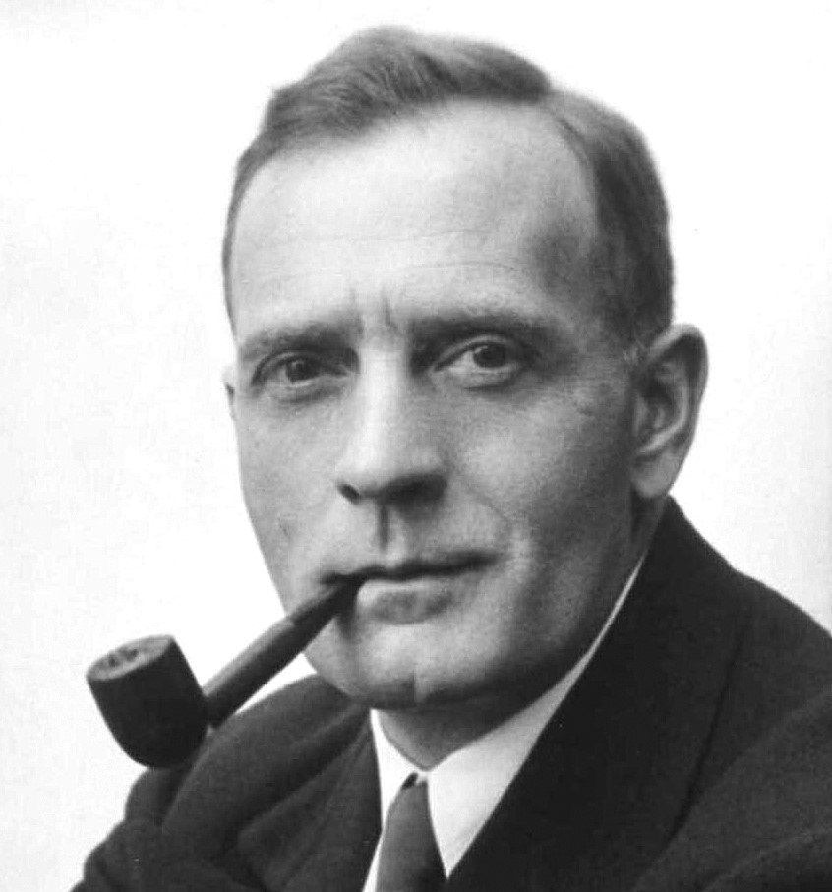

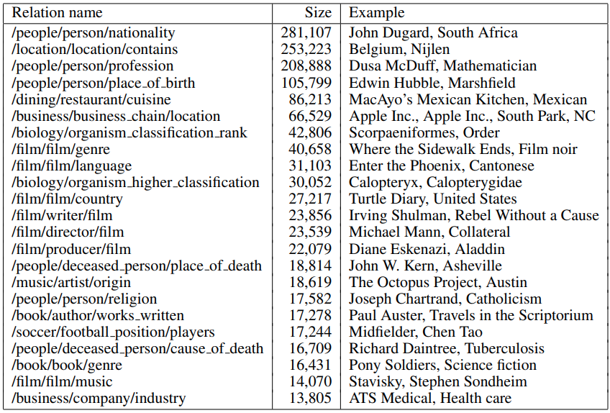
Freebase
entity1
verb
verb
preposition
entity2
entity3
Astronomer
Edwin Hubble
was
born
in
Marshfield
,
Missouri
Freebase only contains NODES and LINKS
The 23 largest Freebase relations we use, with their size and an instance of each relation
[Source: Mintz et al., 2009, Distant supervision for relation extraction without labeled data
Notes:
FREEBASE: a large semantic database of thousands of relations is used to provide distant supervision.
116 million instances of 7,300 relations between 9 million entities
After filtering, 1.8 million instances of 102 relations (940,000 entities)
Collected from a variety of sources.
Launched: 3 March 2007
Current status: Offline (since 2 May 2016), succeeded by Wikidata
URL: www.freebase.com
Reference: https://en.wikipedia.org/wiki/Freebase_(database)

Slide 12
How to build relation extractors? Approaches
Manual
Supervised (ACE)
Unsupervised
Notes:
Manual: Using rules
Supervised: Sentences in a corpus are firsthand-labeled for the presence of entities and the relations between them. Limited to small datasets
Unsupervised: Extracts strings of words between entities in large amounts of text, and clusters and simplifies these word strings to produce relation-strings. However, the resulting relations may not be easy to map to relations needed for a particular knowledge base.
Since the algorithm is ALSO supervised (by a data base rather than by labeled text) it does not suffer from the problems of overfitting and domain-dependence that plague supervised systems. Supervision by a database also means that, unlike in unsupervised approaches, the output of our classifier uses canonical names for relations.
Bootstrap: Low precision and semantic drift
Since the algorithm is ALSO supervised (by a data base rather than by labeled text) it does not suffer from the problems of overfitting and domain-dependence that plague supervised systems. Supervision by a database also means that, unlike in unsupervised approaches, the output of our classifier uses canonical names for relations.
Advantages:
Good-in domain performance
Disadvantages:
Requires lots of human effort for each new relation
Doesn’t generalize much beyond the domain

Slide 13
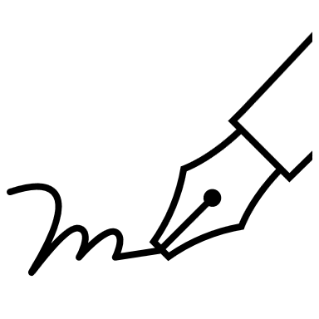
Relation EXTRACTION
PER
GPE
Roderick Perez was in Colombia
Alphabet, the parent company of Google
Bill Gates, co-founder of Microsoft
Person - Located
ORG
ORG
Organization - Organization
PER
ORG
Person - Organization
Notes:
Sentences in a corpus are firsthand-labeled for the presence of entities and the relations between them.
Build issuing human intuition
Start with named entity tags to help extract relation
CONS:
Expensive to produce and limited in quantity.
Resulting classifiers tend to be biased toward that text domain.

Slide 14
Approaches Manual
PER
GPE
Roderick Perez was in Colombia
Person - Located
Positive
Negative
Low-recall
A lot of work for all possible patterns!
Don’t want to have to do this for every relation!
We’d like better accuracy
High-precision
Tailored to specific domains
Notes:
Build issuing human intuition
Start with named entity tags to help extract relation
Negative:
Low-recall
A lot of work to think of all possible patterns!
Don’t want to have to do this for every relation!
We’d like better accuracy

Slide 15
Approaches Supervised
Astronomer
Edwin Hubble
was
born
in
Marshfield
,
Missouri
Notes:
Choose a set of relations we’d like to extract
Choose a set of relevant named entities
Find and label data
Choose a representative corpus
Label the named entities in the corpus
Hand-label the relations between these entities
Break into training, development, and test
Train a classifier on the training set

Slide 16
Approaches Supervised
entity1
verb
verb
preposition
entity2
entity3
Astronomer
Edwin Hubble
was
born
in
Marshfield
,
Missouri
Find all pairs of named entities
Notes:
Choose a set of relations we’d like to extract
Choose a set of relevant named entities
Find and label data
Choose a representative corpus
Label the named entities in the corpus
Hand-label the relations between these entities
Break into training, development, and test
Train a classifier on the training set

Slide 17
Approaches Supervised
entity1
verb
verb
preposition
entity2
entity3
Astronomer
Edwin Hubble
was
born
in
Marshfield
,
Missouri
Find all pairs of named entities
Decide if 2 entities are related
Notes:
Choose a set of relations we’d like to extract
Choose a set of relevant named entities
Find and label data
Choose a representative corpus
Label the named entities in the corpus
Hand-label the relations between these entities
Break into training, development, and test
Train a classifier on the training set

Slide 18
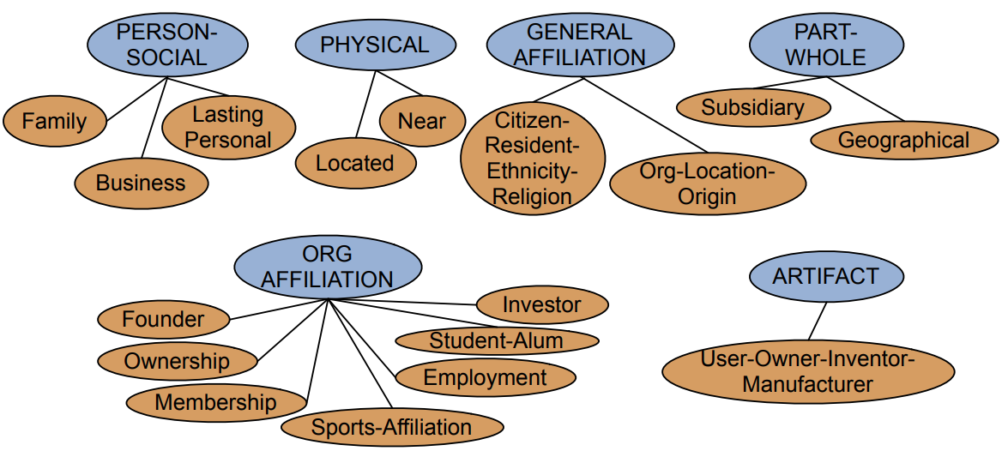
Approaches Supervised
entity1
verb
verb
preposition
entity2
entity3
Astronomer
Edwin Hubble
was
born
in
Marshfield
,
Missouri
Find all pairs of named entities
Decide if 2 entities are related
If yes, classify the relation
Automated Content Extraction (ACE)
Notes:
The last step is important because allow faster classification training by eliminating most pairs .
Also, can use distinct feature-sets appropriate for each task.

Slide 19
Approaches Supervised
entity1
verb
verb
preposition
entity2
entity3
Astronomer
Edwin Hubble
was
born
in
Marshfield
,
Missouri
Positive
Negative
Labeling is expensive
Supervised models are brittle
Use only annotated data to train a model.
High accuracies (large hand-labeled training data)
Notes:
The last step is important because allow faster classification training by eliminating most pairs .
Also, can use distinct feature-sets appropriate for each task.
POSITIVE:
Can get high accuracies with enough hand-labeled training data, if test similar enough to training
NEGATIVE
Labeling a large training set is expensive
Supervised models are brittle, don’t generalize well to different genres
Use only annotated data to train a model.

Slide 20
Approaches bootstrapping
Tuple:
<author, book>
Start with 5 seeds:
Author | Book
Isaac Asimov | The Robots of Dawn
David Grin | Startide Rising
James Gleick | Chaos: Making a New Science
Charles Dickems | Great Expectations
William Shakespeare | The Comedy of Errors
Brin, Sergei. 1998. Extracting Patterns and Relations from the World Wide Web
Notes:
Gather a set of seed pairs that have relation R
Iterate:
1. Find sentences with these pairs
2. Look at the context between or around the pair and generalize the context to create patterns
3. Use the patterns for grep for more pairs

Slide 21
Approaches bootstrapping
Tuple:
<author, book>
Start with 5 seeds:
Author | Book
Isaac Asimov | The Robots of Dawn
David Grin | Startide Rising
James Gleick | Chaos: Making a New Science
Charles Dickems | Great Expectations
William Shakespeare | The Comedy of Errors
Find Instances:
Brin, Sergei. 1998. Extracting Patterns and Relations from the World Wide Web
The Comedy of Error, by William Shakespeare, was…
The Comedy of Error, by William Shakespeare, is…
The Comedy of Error, one of William Shakespeare’s earliest attempts…
The Comedy of Error, one of William Shakespeare’s most…
Notes:
Gather a set of seed pairs that have relation R
Iterate:
1. Find sentences with these pairs
2. Look at the context between or around the pair and generalize the context to create patterns
3. Use the patterns for grep for more pairs

Slide 22
Approaches bootstrapping
Tuple:
<author, book>
Start with 5 seeds:
Author | Book
Isaac Asimov | The Robots of Dawn
David Grin | Startide Rising
James Gleick | Chaos: Making a New Science
Charles Dickems | Great Expectations
William Shakespeare | The Comedy of Errors
Find Instances:
Brin, Sergei. 1998. Extracting Patterns and Relations from the World Wide Web
The Comedy of Error, by William Shakespeare, was…
The Comedy of Error, by William Shakespeare, is…
The Comedy of Error, one of William Shakespeare’s earliest attempts…
The Comedy of Error, one of William Shakespeare’s most…
Extract patterns (group by middle, take longest common prefix/suffix)
?x, by ?y, was…
?x, by ?y, is…
?x, one of ?y’s earliest attempts…
?x, one of ?y’s most…
Notes:
Gather a set of seed pairs that have relation R
Iterate:
1. Find sentences with these pairs
2. Look at the context between or around the pair and generalize the context to create patterns
3. Use the patterns for grep for more pairs

Slide 23
Approaches bootstrapping
Tuple:
<author, book>
Start with 5 seeds:
Author | Book
Isaac Asimov | The Robots of Dawn
David Grin | Startide Rising
James Gleick | Chaos: Making a New Science
Charles Dickems | Great Expectations
William Shakespeare | The Comedy of Errors
Find Instances:
Brin, Sergei. 1998. Extracting Patterns and Relations from the World Wide Web
The Comedy of Error, by William Shakespeare, was…
The Comedy of Error, by William Shakespeare, is…
The Comedy of Error, one of William Shakespeare’s earliest attempts…
The Comedy of Error, one of William Shakespeare’s most…
Extract patterns (group by middle, take longest common prefix/suffix)
?x, by ?y, was…
?x, by ?y, is…
?x, one of ?y’s earliest attempts…
?x, one of ?y’s most…
Iterate, finding new seeds that match the pattern
Notes:
Gather a set of seed pairs that have relation R
Iterate:
1. Find sentences with these pairs
2. Look at the context between or around the pair and generalize the context to create patterns
3. Use the patterns for grep for more pairs

Slide 24
Distant supervision Intuition
… if two entities participate in a relation, any sentence that contains a pair of entities that participate in a known Freebase relation is likely to express that relation in some way.
…extract very large numbers of features that are combined in a logistic regression classifier.
More text, more relations, and more instances.
Notes:
Notice that some of this entity pairs might contain noise data as well. In theory, large number of features reduce the number of bad classifiers. In that case, the algorithm trains a multiclass logistic regression classifier, learning weights for each noisy feature.
Combine bootstrapping with supervised learning
Instead of 5 seeds:
Use a large database to get large # of seed examples
Create lots of features from all these examples
Combine in a supervised classifier

Slide 25
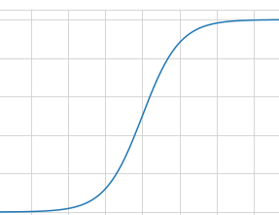

DISTANT SUPERVISION sUMMARY
102 relations
940K entities
1.8 instances
train
annotate
Logistic Regression Classifier
train
Notes:
102 relations
940K entities
1.8 instances

Slide 26
Distant supervision Summary
For each relation
born - in
Notes:
All entities are identified in sentences using a named entity tagger that labels persons, organizations and locations.
Named entity tagger: All entities are identified in sentences using a named entity tagger that labels persons, organizations and locations.
If a sentence contains two entities and those entities are an instance of one of the Freebase relations, features are extracted from that sentence and are added to the feature vector for the relation.

Slide 27
Distant supervision Summary
For each relation
For each tuple in big database
study - in
<Edwin Hubble – Marshfield>
<Albert Einstein– Ulm>

Slide 28
Distant supervision Summary
For each relation
For each tuple in big database
Find sentences in large corpus with both entities
born - in
<Edwin Hubble – Marshfield>
<Albert Einstein– Ulm>
Edwin Hubble was born in Marshfield
Einstein, born (1879), Ulm

Slide 29
Distant supervision Summary
For each relation
For each tuple in big database
Find sentences in large corpus with both entities
Extract frequent features
born - in
<Edwin Hubble – Marshfield>
<Albert Einstein– Ulm>
Edwin Hubble was born in Marshfield
Einstein, born (1879), Ulm
PER was born in LOC
PER, born (1879), LOC

Slide 30
Distant supervision Summary
For each relation
For each tuple in big database
Find sentences in large corpus with both entities
Extract frequent features
Train classifier
born - in
<Edwin Hubble – Marshfield>
<Albert Einstein– Ulm>
Edwin Hubble was born in Marshfield
Einstein, born (1879), Ulm
PER was born in LOC
PER, born (1879), LOC

Slide 31
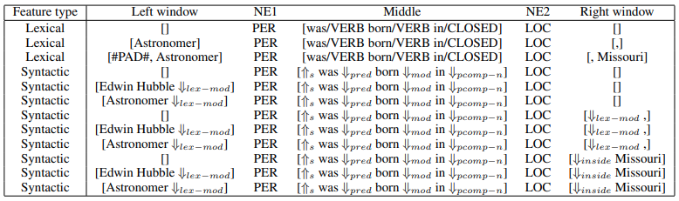
FEATURES Lexical
entity1
verb
verb
preposition
entity2
entity3
Astronomer
Edwin Hubble
was
born
in
Marshfield
,
Missouri
https://parts-of-speech.info/
Variations*:
omitting all words that are not verbs,
omitting all function words.
Precision increment, but not large enough to justify the computational effort.
*attempt to approximate syntactic features
Notes:
Features: describes how two entities are related in a sentence, using either syntactic or non-syntactic information.
Lexical: specific words between and surrounding the two entities.
The sequence of words between the two entities
The part-of-speech tags of these words
A flag indicating which entity came first in the sentence
A window of k words to the left of Entity 1 and their part-of-speech tags
A window of k words to the right of Entity 2 and their part-of-speech tags

Slide 32
FEATURES Syntactic
entity1
entity2
entity3
Astronomer
Edwin Hubble
was
born
in
Marshfield
,
Missouri
Dependency path between
each pair of entities
pre
pre
mod
Grammatical Relationships
Symbol | Description
inv-aux | inverted auxiliary
mod | relationship between a word and its adjunct modifier
pnmod | post nominal modifier
p-spec | specifier of prepositional phrases
pcomp-c | clausal complement of prepositions
pcomp-n | nominal complement of prepositions
post | post determiner
pre | pre determiner
s | surface subjec
https://gate.ac.uk/releases/gate-7.0-build4195-ALL/doc/tao/splitch17.html
Notes:
Dependency path between each pair of entities.
A dependency path consists of a series of dependencies, directions and words/chunks representing a traversal of the parse. Part-of-speech tags are not included in the dependency path.
Window node is a node connected to one of the two entities and not part of the dependency path.
Features based on syntax
A dependency path between the two entities
For each entity, one ‘window’ node that is not part of the dependency path
Broad-coverage dependency parser MINIPAR =>directional dependencies

Slide 33
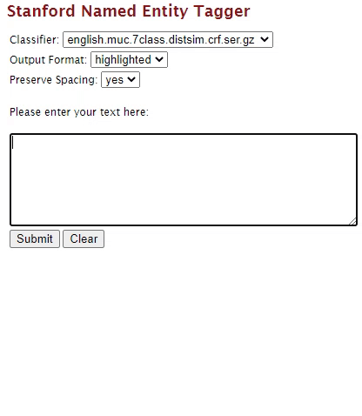
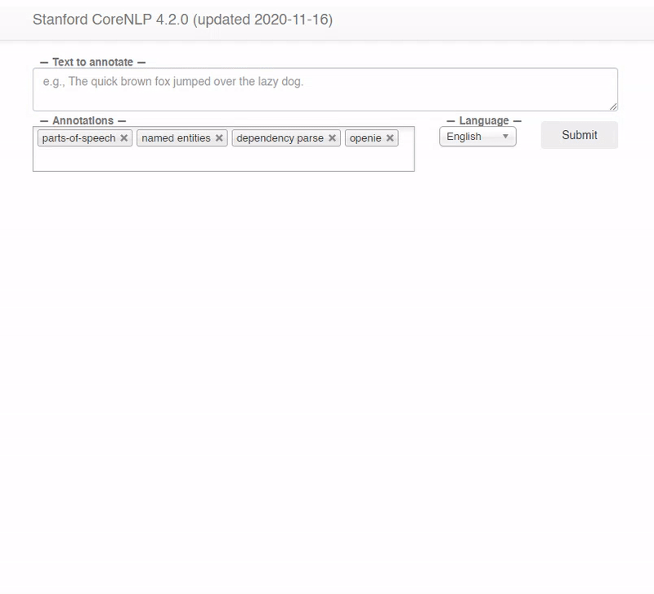
FEATURES named entity tags - Stanford NAMED ENTITY TAGGER
Reference:
http://nlp.stanford.edu:8080/ner/
Reference:
http://corenlp.run/
Notes:
Every feature contains, in addition to lexical and syntactic features, named entity tags for the two entities.
Goal, extract the Person, Location, Organization, Miscellaneous, None
Both projects are part of the Stanford Named Entity Recognizer (NER)

Slide 34
FEATURES named entity tags - Stanford NAMED ENTITY TAGGER
Reference:
http://nlp.stanford.edu:8080/ner/
Reference:
http://corenlp.run/
Notes:
Every feature contains, in addition to lexical and syntactic features, named entity tags for the two entities.
Goal, extract the Person, Location, Organization, Miscellaneous, None
Both projects are part of the Stanford Named Entity Recognizer (NER)

Slide 35
FEATURES FEATURE CONJUNCTIONS
Example
Reference:
http://corenlp.run/

Slide 36
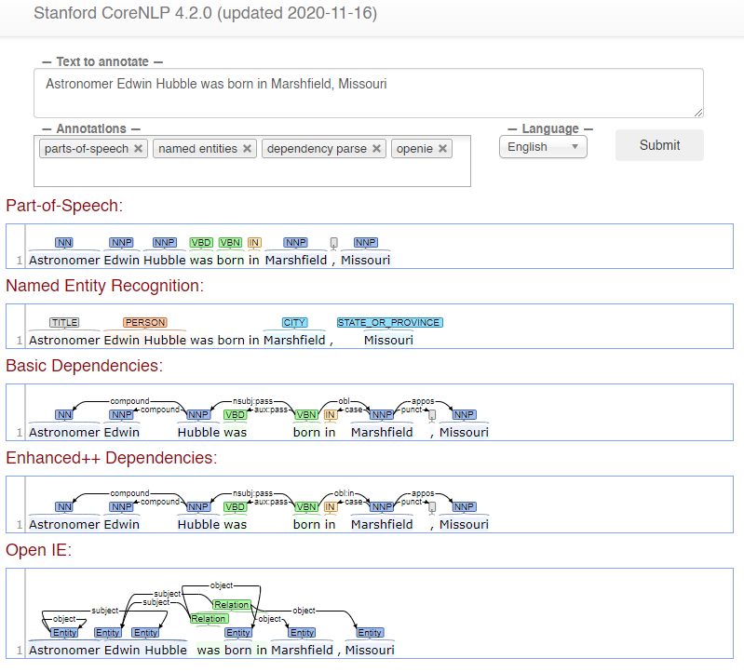
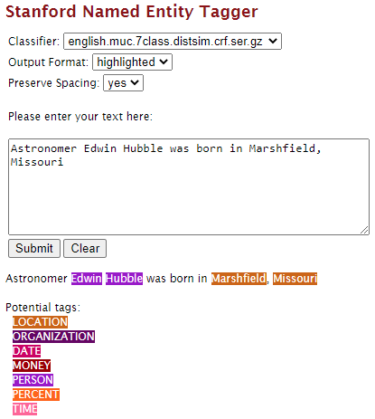
FEATURES FEATURE CONJUNCTIONS
Named Entity Tags
+
Attributes in sentence
Recall
Precision
Large dataset
Notes:
For two features to match, all their conjuncts must match exactly. This yields low-recall but high-precision features. With a small amount of data, this approach would be problematic, since most features would only be seen once, rendering them useless to the classifier. Since we use large amounts of data, even complex features appear multiple times, allowing our high precision features to work as intended.

Slide 37
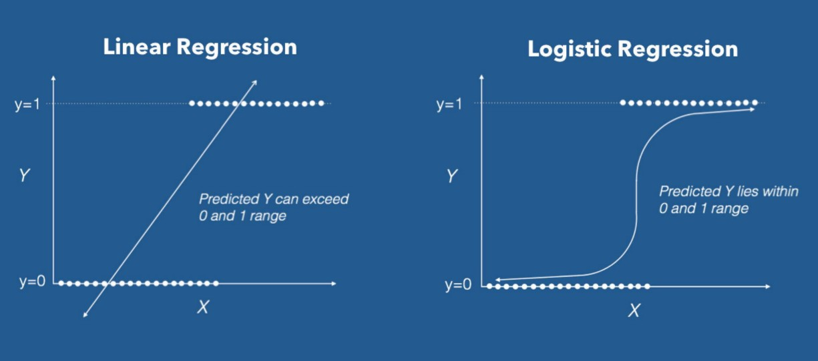
IMPLEMENTATION multi-class logistic classifier optimized using L-BFGS with Gaussian regularization

Slide 38
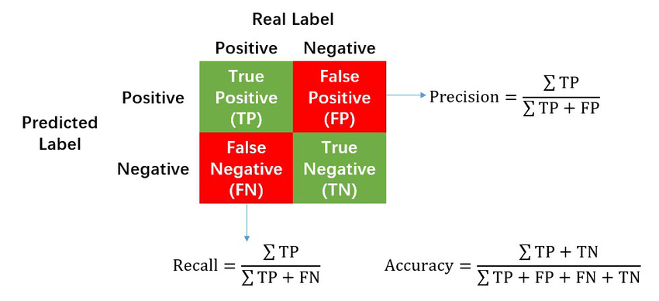
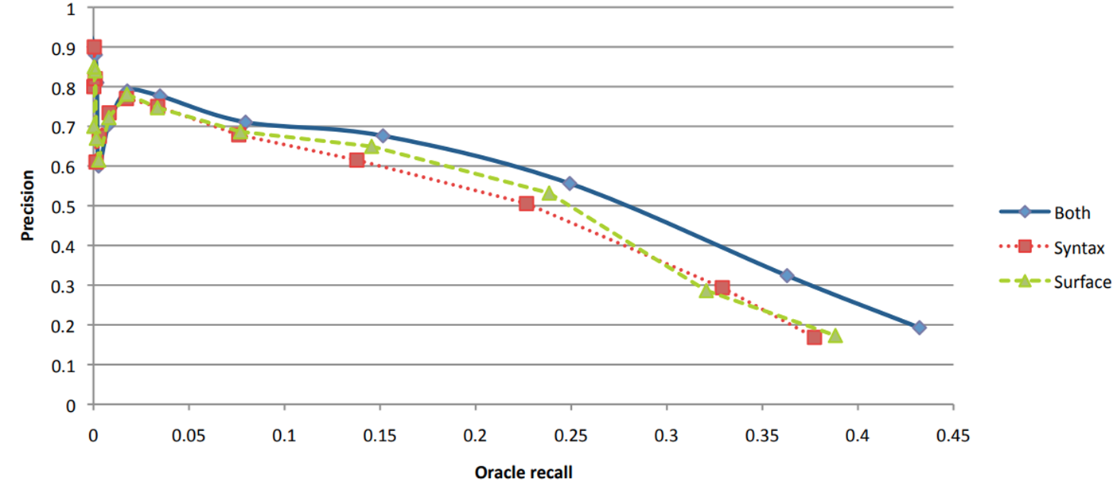
EVALUATION Automatic – held-out
Combination of syntactic and lexical features provides better performance than either feature set on its own.
Automatically
Training: 900 K Instance relations
Held-out data
compare
Newly Discovered
The combination of syntactic and lexical features offers a substantial improvement in precision over either of these feature sets on its own.
At the 100,000-recall level, we classify most of the instances into three relations:
60% as location-contains
13% as person-place-of-birth
10% as person-nationality
Automatic evaluation with 50% of Freebase relation data held out and 50% used in training on the 102 largest relations we use.
[Source: Mintz et al., 2009, Distant supervision for relation extraction without labeled data
Notes:
Held-out evaluation suffers from false negatives, it gives a rough measure of precision without requiring expensive human evaluation, making it useful for parameter setting.

Slide 39



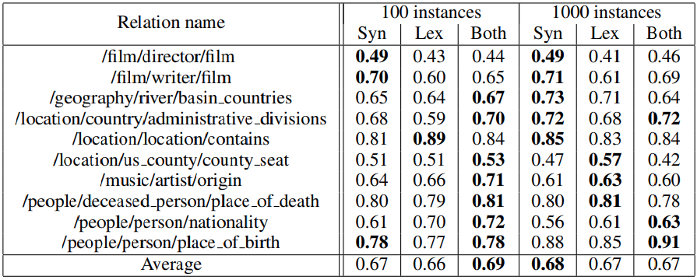
EVALUATION HUMAN
relation1
Test Data
…
Samples
entity1
entity2
Instance 1
Instance 2
Instance 3
Instance 4
Instance 5
Instance 6
Instance 7
Instance 8
…
…
…
Instance 99
Instance 100
Instance 101
Instance 102
Instance 103
Instance 104
…
Instance 998
Instance 999
Instance 1000
Instance 1001
Instance 1002
relation3
Relation 1
Relation 2
Relation 3
Relation 4
Relation 5
Relation 6
Relation 7
Relation 8
Relation 9
Relation 10
Relation 11
Relation 12
Relation 13
Relation 14
Relation 15
…
Relation n-1
Relation n
relationz
Amazon’s Mechanical Turk service
1
2
3
Manually
First 100
Most frequent relations
Labelers
https://www.mturk.com/
Syntactic features
First 1000
Lexical features
Syntactic + Lexical features
Estimated precision on human-evaluation experiments of the highest-ranked 100 and 1000 results per relation, using stratified samples..
[Source: Mintz et al., 2009, Distant supervision for relation extraction without labeled data
Notes:
We assigned the truth or falsehood of each relation according to the majority vote of the labels; in the case of a tie (one vote each way) we assigned the relation as true or false with equal probability.
We use stratified samples because of the overabundance of location-contains instances among our high-confidence results.
The authors claimed that “At a recall of 100 instances, the combination of lexical and syntactic features has the best performance for most of the relations (0.6, while at a recall level of 1000 instances the results are mixed. No feature set strongly outperforms any of the others across all relations. However, both results are not clear in terms of significance.

Slide 40
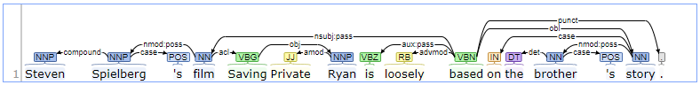
RESULTS DISCUSSION
noun
verb
Saving
Private
Ryan
determiner
preposition
Example 1
adverb
Chunking
entity1
entity2
Steven Spielberg
‘s
film
Saving Private Ryan
is
loosely
based
on
the
brother’s
story.
Relations:
film-director
film-writer
film-producer
Notes:
Syntactic features (sequence of words between the two entities) consistently outperform lexical features for the director-film and writer-film relations. These two relations are particularly ambiguous, suggesting that syntactic features may help tease apart difficult relations.

Slide 41
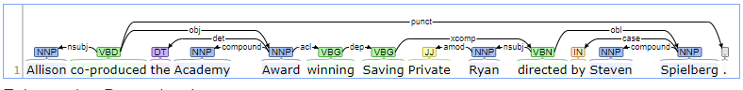
RESULTS DISCUSSION
noun
What is ???
Film?
TV show?
Book?
verb
determiner
preposition
Example 2
adverb
entity1
entity2
entity3
Allison
co-produced
the
Academy Award
winning
Saving Private Ryan
directed
by
Steven Spielberg
???
entity1
entity2
Robert Mueller
directed
the
FBI
Relations:
film-director
CEO-company
In case of ambiguous relations, syntactic features are important.
Estimated precision on human-evaluation experiments of the highest-ranked 100 and 1000 results per relation, using stratified samples..
[Source: Mintz et al., 2009, Distant supervision for relation extraction without labeled data
Notes:
Syntactic features consistently outperform lexical features for the director-film and writer-film relations.
Syntactic features can more easily abstract from the syntactic modifiers that comprise the extraneous parts of these strings.

Slide 42
Conclusions
Extract relations from unlabeled text
Using database, the label is suit for the current database
Extracted relations has a 67% of accuracy.
Distant supervision for relation extraction without labeled data (2009)
Authors: Mike Mintz, Steven Bills, Rion Snow, Dan Jurafsky
Notes:
Distant supervision:
May have access to labeled data.
Access to a pool of unlabeled data.
Operator which samples data from the large pool and labels them. This operator is expected to be noisy in its labels.
Effectively utilizes the training labeled data and the new noisy labeled data to give a final output.
Distant supervision algorithm can extract high-precision patterns for a reasonable large number of relations.
Model can extract 10,000 instances of 102 relations at a precision of 67.6%.
In case of the held-out results, the combination of syntactic and lexical features provides better performance than either feature set on its own.
Human evaluation
Top 100 instances:
“…most of the best results use syntactic features, either alone or in combination with lexical features.”
Top 1,000 instances:
“…the results are more mixed, but syntactic features still helped in most classifications.”
In Distantly supervised information extraction Syntactic features are useful in cases where the individual patterns are particularly ambiguous, and where they are nearby in the dependency structure but distant in terms of words.

Slide 43
DISCUSSION
Distantly supervision can be useful for other taks.
It is necessary to have a large database.
Distant supervision for relation extraction without labeled data (2009)
Authors: Mike Mintz, Steven Bills, Rion Snow, Dan Jurafsky
Notes:
Algorithm is supervised by Database, rather than supervised by labelled text.
Since we are using Freebase relation (instead of hand labelled), it does not suffer from over-fitting based on domain.
Needed an existing database to start from.
Freebase relations is highly unbalanced since more than 53.4% of the relations belongs to 3 categories: people/person/nationality (20.2%), location/location/contains (18.2%), and people/person/profession (15%).
Not all the sentences with related entities are truly positive examples (noise).
At the time to evaluate the model performance (human evaluation) between 100 (0.67) and 1,000 (0.68) instances the results (average) are not conclusive.
Was necessary to use use stratified sampling because of the overabundance of location-contains instances among the high-confidence results.
Distantly supervised works well for large-scale relation extraction. However, it is trapped in the wrong labeling problem for positive instances.
Currently the number of published articles is three times larger than the one used in the research.

Slide 44
Thanks
Questions?

Slide 45
Approaches Manual
PER
GPE
Roderick Perez was in Colombia
Person - Located

Slide 46
Approaches bootstrapping
Tuple:
<Edwin Hubble, Missouri>
entity
entity
entity
Astronomer
Edwin Hubble
was
born
in
Marshfield
,
Missouri
X was born in Y
Notes:
Semi-Supervised=> Bootstrapping: use the seeds to directly learn to populate a relation
No training set? Maybe you have:
A few seed tuples or
A few high-precision patterns

Slide 47
Approaches bootstrapping
Tuple:
<Edwin Hubble, Missouri>
entity
entity
entity
Astronomer
Edwin Hubble
was
born
in
Marshfield
,
Missouri
X was born in Y
entity1
entity
entity
The
house
where
Edwin Hubble
was
born
is
in
Marshfield
,
Missouri
The house where X was born is in Y
Notes:
Bootstrapping: use the seeds to directly learn to populate a relation
No training set? Maybe you have:
A few seed tuples or
A few high-precision patterns

Slide 48
Approaches bootstrapping
Tuple:
<Edwin Hubble, Missouri>
entity
entity
entity
Astronomer
Edwin Hubble
was
born
in
Marshfield
,
Missouri
X was born in Y
entity1
entity
entity
The
house
where
Edwin Hubble
was
born
is
in
Marshfield
,
Missouri
The house where X was born is in Y
entity
Missouri
is
the
homestate
of
Edwin Hubble
Y is the homestate of X
Use those patterns to grep new tuples
Notes:
Gather a set of seed pairs that have relation R
Iterate:
1. Find sentences with these pairs
2. Look at the context between or around the pair and generalize the context to create patterns
3. Use the patterns for grep for more pairs

Slide 49
SUMMARY and KEY POINTS
New sentence (using NER):
Check for sentences which Named Entity Tagged exist in a known Freebase relation.
Since there is a large dataset, many sentence might cover such relation (larger text, more potential features).
Use a Logistic classifier to map the relation
entity1
entity2
Vienna
is
the
capital
of
Austria
FreeBase
Distant supervision for relation extraction without labeled data (2009)
Authors: Mike Mintz, Steven Bills, Rion Snow, Dan Jurafsky
Bogota is the capital of Colombia
Richmond, is the capital of Virginia
Caracas is the capital of Venezuela
…
Henry’s of Nantes helped … in France
location – contains
film – director
film – writer
music – art - origin
…
people/profession
If two entities have a known relation in a knowledge base, all sentences that mention these two entities will probably express the same relation.

Slide 50
Distant supervision Summary
Supervised Classification
Unsupervised Classification
Uses very large amounts of unlabeled data
Not sensitive to genre issues in training corpus
Uses a classifier with lots of features
Supervised by detailed hand-created knowledge
Doesn’t require iteratively expanding patterns

Slide 51
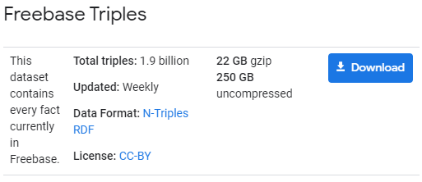
IMPLEMENTATION TEXT
Unstructured
https://developers.google.com/freebase/
Wikipedia*
Articles: 1.8 M
Sentence per article: 14.3 / article
Words: 601,600,703
Structured
Relation 1
Relation 2
X study at Y
…
Relation n-1
Relation n
Feature 1
Feature 2
Feature 3
…
Feature n-1
Feature n
Entity 1
Entity 2
Entity 3
…
Entity n-1
Entity n
Freebase Wikipedia Extraction
https://github.com/saleiro/Freebase-to-Wikipedia
Training: 900 K Instance relations**
NEW relation
Training
800 K
Testing
400 K
extract relation instances that do not appear in our training data (not already in Freebase).
*not including discussion or user pages.
** originally 1.8 M (only used for human evaluation experiments during training).
Notes:
Wikipedia because it is relatively up to-date, and because its sentences tend to make explicit many facts that might be omitted in newswire.

Slide 52
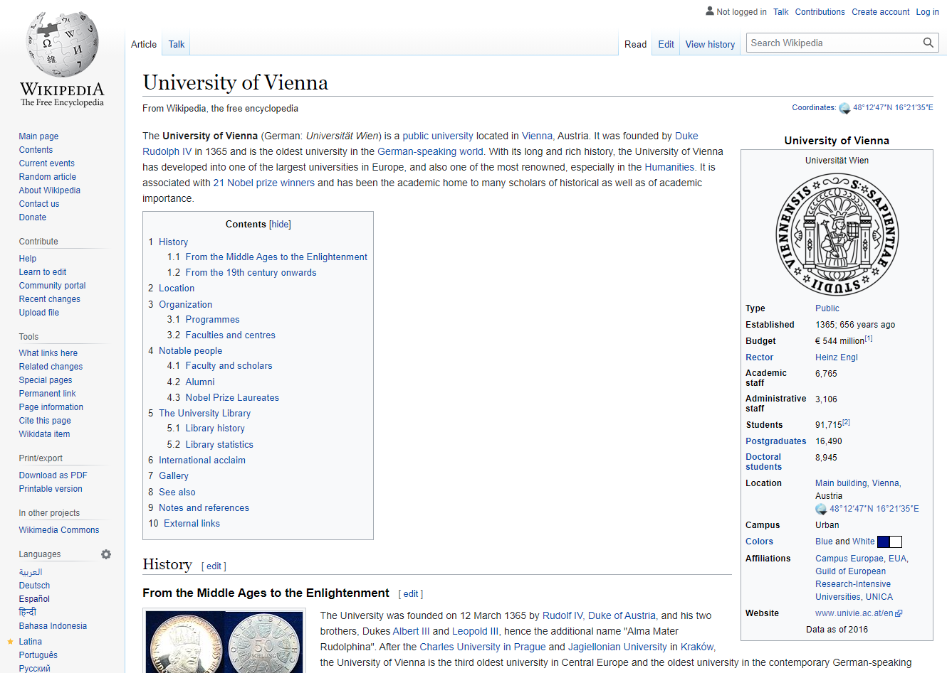
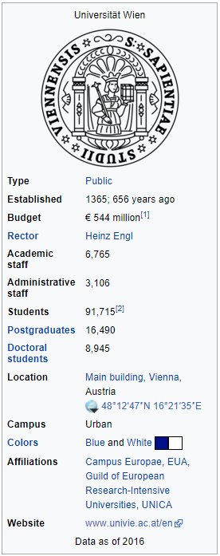
Freebase-WIKIPEDIA
Wikipedia
Wikipedia Infobox
Relations
ORG
GPE
UniWien location Vienna
Organization - Located

Slide 53
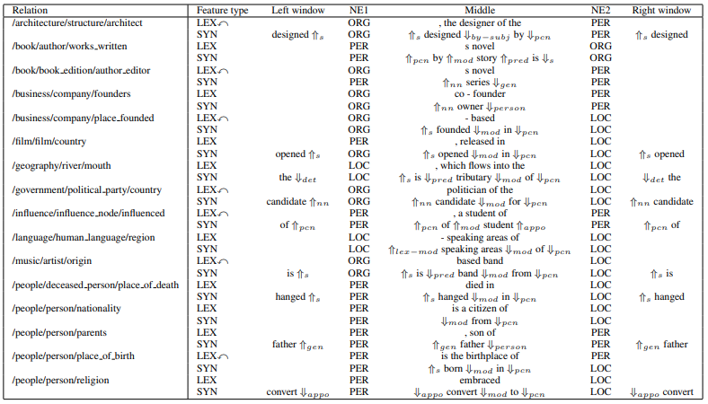
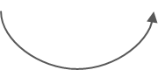
CLASSIFICATION RESULTS
SYN
syntactic feature
LEX
lexical feature
reversed
NE#
named entity tag of entity
Examples of high-weight features for several relations
[Source: Mintz et al., 2009, Distant supervision for relation extraction without labeled data

Slide 54
IMPLEMENTATION PARSING AND CHUNKING
PreProcessing
Edwin/PERSON
Hubble/PERSON
Astronomer
Edwin
Hubble
was
born
in
Marshfield
,
Missouri
Chunking*
[Edwin Hubble] /PERSON
Astronomer
Edwin Hubble
was
born
in
Marshfield
,
Missouri
*restricted by the dependency parse of the sentence.

Slide 55
RECENT WORK
entity1
entity2
Steve Jobs
was
the
chairman
and
co-founder
of
Apple Inc.
[Steve Jobs, founder, Apple Inc.]
False Positive Intances
GAN Driven Semi-distant Supervision for Relation Extraction
Author: Shanghai Jiao Tong University
entity1
entity2
Steve Jobs
resigned
as
the
CEO
of
Apple Inc.
in
2011
[Steve Jobs, founder, Apple Inc.]
Assumption
If an entity relevant to another entity, its name is possibly mentioned in the description of the other entity.
Steve Jobs
Apple Inc.
Steve Jobs
USA

Slide 56
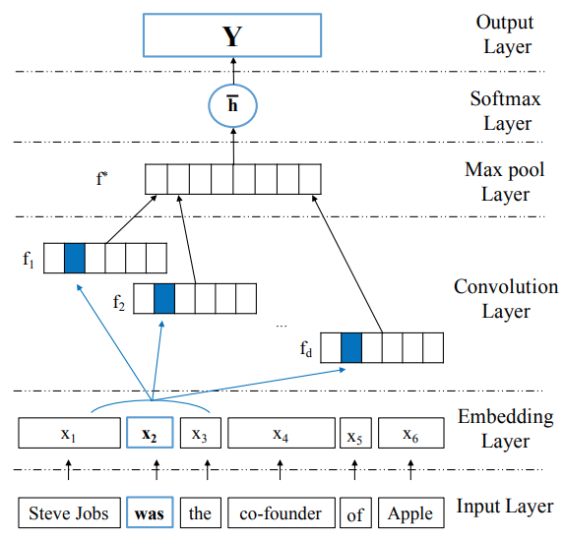
RECENT WORK
GAN Driven Semi-distant Supervision for Relation Extraction
Author: Shanghai Jiao Tong University

Slide 57
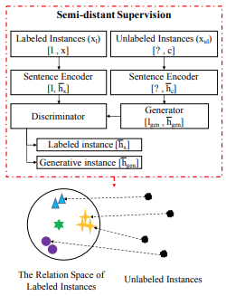
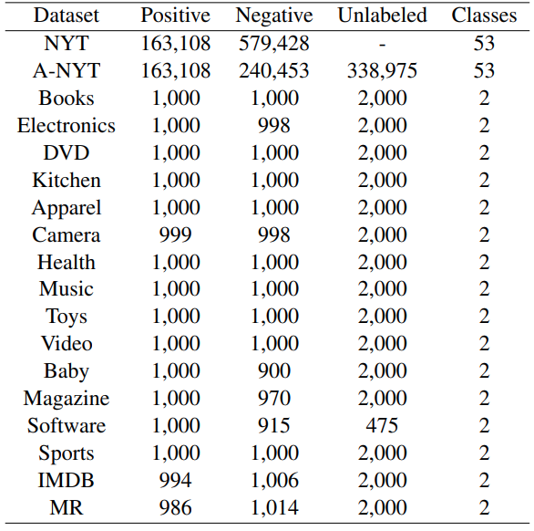
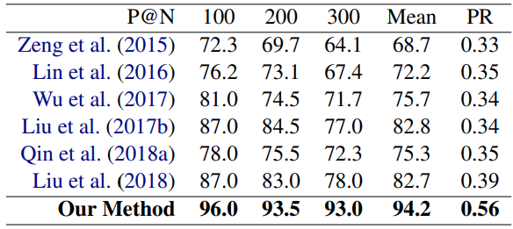
RECENT WORK
Datasets
GAN Driven Semi-distant Supervision for Relation Extraction
Author: Shanghai Jiao Tong University
Results

Slide 58
Distant supervision hypernym (is – a)
Hypernym
Color
Hyponym is a word that can be changed with a different and less precise word without changing the overall meaning of the phrase.¹
Hyponyms
Red
Blue
Yellow
Cherry
Ferrari
ruby
Source: https://simple.wikipedia.org/wiki/Hyponymy_and_hypernymy
Notes:
Distant supervision is an extension of the paradigm used by Snow et al. (2005) for exploiting WordNet to extract hypernym (is-a) relations between entities.

Slide 59
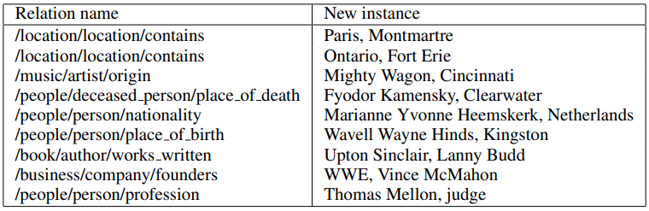
RELATION EXTRACTION
Ten relation instances extracted by the system that did not appear in Freebase
[Source: Mintz et al., 2009, Distant supervision for relation extraction without labeled data

